Slide 1
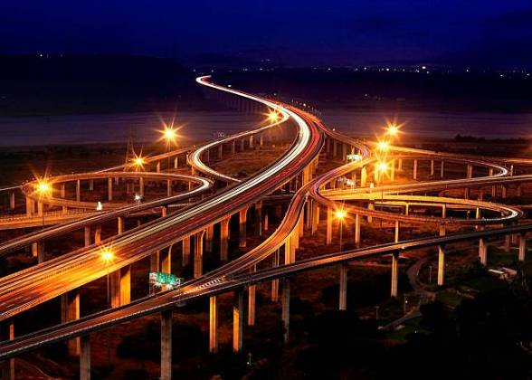
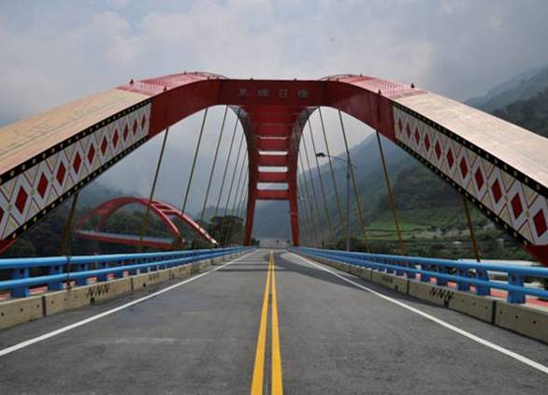
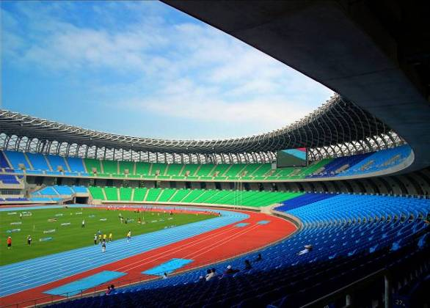
行政院公共工程委員會
Public Construction Commission (PCC)
Executive Yuan
May 17, 2021

Slide 2

目 錄 / Content
I.
本會簡介 / PCC Overview
II.
政府採購 / Government Procurement
III.
工程技術 / Technology
IV.
工程管理 / Construction Management
V.
爭議處理 / Dispute Settlement
VI.
技術鑑定 / Technique Corroboration
VII.
結語 / Conclusion
Notes:
1

Slide 3
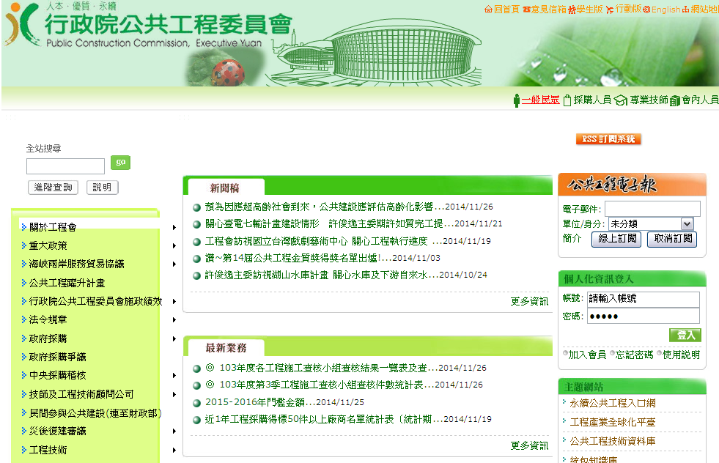
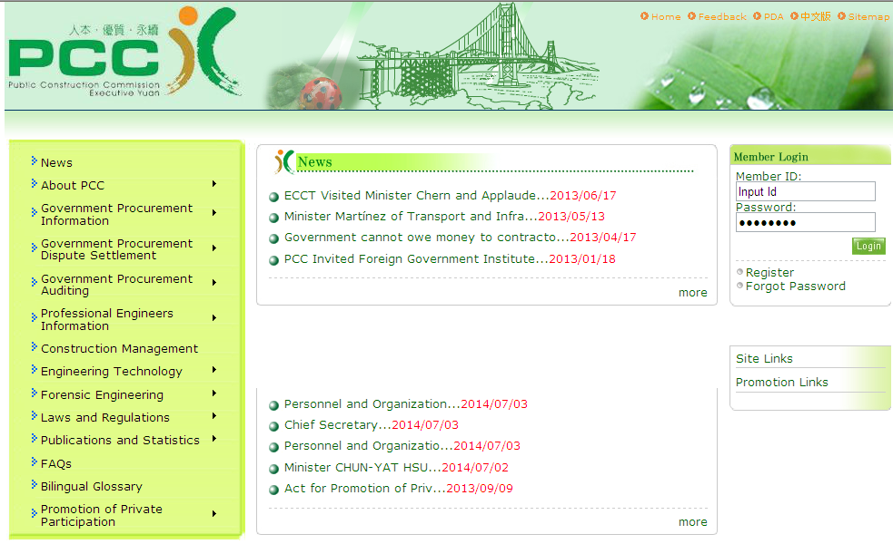
I.本會簡介 / PCC Overview
i. 關於本會 / About PCC
行政院公共工程委員會為行政院所屬機關，與部同級。
PCC is an entity equal to a ministry under the cabinet.
行政院公共工程委員會統籌全國公共工程之規劃、審議、協調及督導。
PCC takes the responsibilities of planning, reviewing, coordination, and supervision for public construction projects as a whole in Taiwan.
Notes:
2
Our commission is a ministerial level entity under the cabinet, and we are responsible for the planning, reviewing, coordination, and supervision of public infrastructure.
本會為行政院公共工程專業幕僚機關，統籌全國公共工程之規劃、審議、協調及督導。

Slide 4
企劃處
Department of Planning
I.本會簡介/PCC Overview
技術處
Department of Technology
工程管理處
Department of Construction Management
ii. 組織架構 / Organization
秘書處
Secretariat
人事室
Personnel Office
主計室
Accounting and Statistics Office
主任委員
Minister
副主任委員
Deputy Minister
法規委員會
Legal Affairs Committee
訴願審議委員會
Administrative Appeal Review Committee
委員會議
Board of Commissioners
主任秘書
Chief Secretary
採購申訴審議委員會
Complaint Review Board for GP
中央採購稽核小組
Central Procurement Supervision Unit
工程技術鑑定委員會
Engineering Technique Corroboration Committee
國會聯絡組
Congressional Liaison Unit
資訊推動小組
Information Technology Unit
Notes:
3
The Minister and two Deputy Ministers of the PCC are appointed by the President upon the recommendation of the Premier.
本會主任委員及兩位副主任委員係由行政院院長提請總統任命。
The PCC is divided into 3 main departments, 3 committees and administrative supporting offices as shown in Fig.
本會組織目前設置3個業務處、3個委員會及其它行政支援單位，如圖所示。

Slide 5
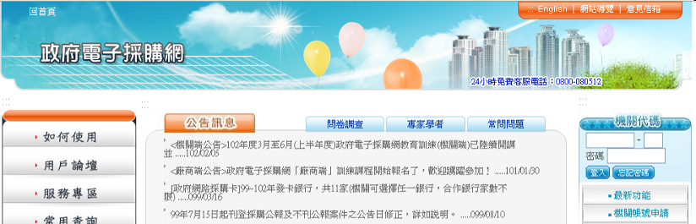
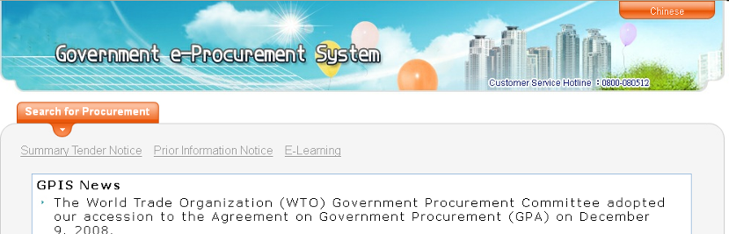
I.本會簡介 / PCC Overview
iii. 主管法令及主要業務 / Laws and Major Functions
政府採購法 / Government Procurement Act
技師法 / Professional Engineers Act
工程技術顧問公司管理條例 / Act Governing the Administration of Professional Engineering Consulting Firms
上述法令之施行細則及相關規定 / Rules and Regulations of the Aforementioned Acts
Notes:
4
We are in charge of Government Procurement Act, Professional Engineers Act, and Act Governing the Administration of Professional Engineering Consulting Firms, and their relevant rules.
本會主管法令包括政府採購法、技師法、工程技術顧問公司管理條例及其相關規定。

Slide 6
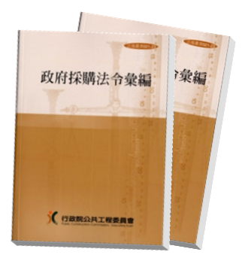
II.政府採購 / Government Procurement
i. 政府採購法 / Government Procurement Act
生效日：1999年5月27日
Effective Date: May 27, 1999
政府採購法符合世界貿易組織(WTO)政府採購協定(GPA)規定
In consistent with the WTO Agreement on Government Procurement (GPA)
我國於2009年7月15日正式成為GPA的第41個會員，與GPA會員相互開放政府採購市場。
Taiwan has become the 41st member to the GPA since July 15, 2009, and mutually opened government procurement market with other GPA members.
Notes:
5
As the responsible entity of the Government Procurement Act, the PCC implements a fair, open, just, efficient, and high-quality government procurement system. PCC tackles the relevant government procurement issues which involves foreign elements, and continues on international interactions and mutual learning, to build an incorrupt, impartial and fair procurement environment.
本會為政府採購法主管機關，依法落實公平、公開、公正、效率及品質的政府採購制度。對於涉外主要業務為政府採購部分，本會持續辦理國際交流，相互學習，以建構一個更清廉、公正、合理採購環境。
PCC is the responsible entity in Taiwan for the consultation of mutual access to the government procurement market with the other countries.
我國與其他國家相互開放政府採購市場，本會為負責諮商機關。

Slide 7
II.政府採購 / Government Procurement
ii. 政府採購法規 / Government Procurement Laws and Regulations
政府採購法明定招標、決標、履約管理、驗收及爭議處理之規定，使機關辦理採購有所依循，其中並包括採購人員倫理準則等反貪腐機制。工程會訂頒各種招標文件範本供各機關參考利用。
Government Procurement Act prescribes the rules of invitation to tender, award of contracts, administration of contract performance, inspection and acceptance, and dispute settlement, for government entities to follow. It incorporates some anti-corruption measures, including the ethics regulation for the procurement personnel. PCC has issued various model documentation as the reference for procuring entities.
Notes:
6
In addition to the Government Procurement Act, PCC has promulgated 42 sub-laws to the GP Act pursuant to the authorization of the Act to construct a government procurement system with complete functions. For reducing mistakes and oversights, the PCC has issued models of tender documentation for procuring entities' practical operational needs. Such regulations and samples are reviewed and amended by PCC in due time.
本會依採購法之授權訂頒42項子法，以完備整體政府採購制度。另為利機關辦理採購實際運作需要，工程會訂頒招標文件範本供各機關參考利用，以減少採購疏失。工程會並適時修訂相關法規或範本內容。

Slide 8
II.政府採購 / Government Procurement
iii.政府電子採購網 / GEPS (Government E-Procurement System)
推動政府採購電子化，提供機關及廠商辦理政府採購業務之電子化單一窗口，促進採購資訊公開化、透明化，平均每年超過18萬件決標案件資料。
Provide single website e-procurement service for government entities and suppliers to enhance the openness and transparency of procurement information. In average, the number of awarded cases exceeds 180 thousand per year.
機關提供電子領標案件比率逾99%，廠商24小時均可經由政府電子採購網電子領標，平均每案約4家廠商上網領標。
The ratio of cases providing e-tender documentation was more than 99%. Suppliers may download e-tender documentation from website. In average, each tender is downloaded by 4 suppliers.
Notes:
7
(i)
Our GEPS (Government E-Procurement System) provides 24-7 for electronic tender notices, tender documentation, bidding, and award notices to enhance competition, save government expenditure, reduce carbon emissions, avoid bid rigging & collusion, and avoid mistakes by program review.
政府電子採購網提供24小時網路服務，包括電子招標公告、電子領標、電子投標、電子決標公告等，可促進競爭、節省支出、節能減碳、避免綁標、圍標及透過程式檢核避免犯錯。
(ii)
Over the past five years, averagely speaking, there were about 240,000 cases providing e-tender documentation (which is about 99% of the total tenders) and 1,000,000 downloads per year (In average, each tender is downloaded by nearly 4 suppliers).
近五年平均每年招標文件提供電子領標約24萬件(全部招標件數之99%) ；廠商電子領標約100萬次( 平均每案近4家廠商領標)。

Slide 9
II.政府採購 / Government Procurement
iv.採購稽核監督 / Monitoring and Supervisory Functions in GP
稽核監督助於導正機關不當之採購行為，減少採購缺失，促使各機關確實依法辦理採購。
Monitoring and supervision help correct inappropriate procurement behaviors, reduce procurement defects, and encourage entities to abide by the laws faithfully when conducting procurement.
全國共設有38個採購稽核小組，包括15個部會署、22個地方政府及工程會中央採購稽核小組。
There are 38 procurement supervision units in Taiwan: 15 units under central government entities; 22 units under local governments; and the Central Procurement Supervision Unit, PCC.
Notes:
8
There are 38 procurement supervision units in Taiwan: 15 units under central government ministries or commissions; 22 local government units; and the Central Procurement Supervision Unit under PCC. These Units monitor nearly 190,000 procurement cases annually and request agencies to take corrective action when deficiencies are found. This process helps entities to correct inappropriate procurement behavior.
目前全國共設38個採購稽核小組，包括15個中央部會署及22個地方政府及本會中央採購稽核小組，每年可就全國近19萬件之採購案件中，篩選案件辦理稽核，並就所見缺失責請機關改正，有助改善機關不當採購行為。

Slide 10
II.政府採購 / Government Procurement
v.營造公平合理的採購環境 / Build A Fair and Reasonable Procurement Environment
為協助機關擇定合宜之決標方式，以提升採購之效率、功能及品質，訂定「政府採購之決標方式參考原則」，供機關實務作業參考。
In order to assist entities in selecting appropriate awarding methods and promote the efficiency, effectiveness and quality of procurement, PCC has promulgated the “Reference Principles for Awarding Methods of Government Procurement”, providing practical references for entities.
Notes:
9

Slide 11
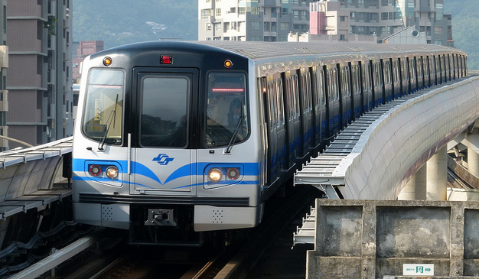
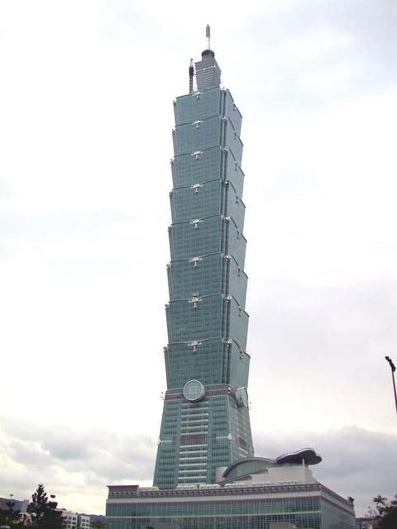
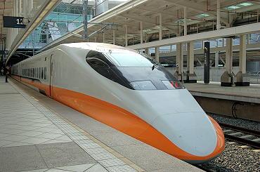
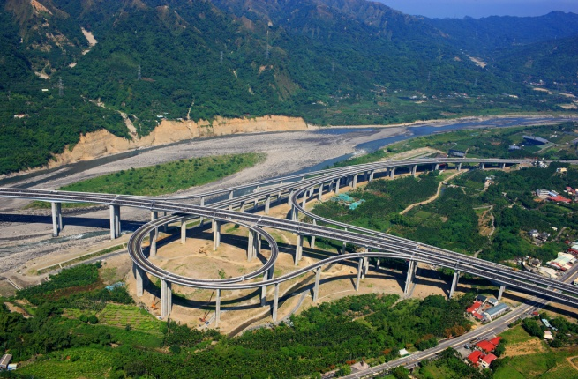
III.工程技術 / Technology
i.工程產業國內實績案例 / Engineering Industry Domestic Case
臺灣的營造業及工程技術服務業具國際一流水準。
Taiwan reaches international level in the construction industry and professional engineering service.
Mass Rapid Transit
Taiwan High Speed Rail
Freeway
Taipei 1O1
Notes:
10
Taiwan reaches international level in the construction industry and professional engineering service.
We completed the achievements of long tunnels, long span bridges, mass rapid transit systems, water resources development, skyscrapers, petrochemical plants, and power plants. In addition, professionals in Taiwan are recognized by international professional organizations, e.g. APEC Engineer and International Professional Engineer.
臺灣的工程技術服務業及營造業具國際一流水準，擁有完成長隧道、大跨距橋梁、捷運建設、水資源開發、超高樓建築、石化廠及電廠等工程實績，技術人員具亞太工程師及國際工程師之專業證照。

Slide 12
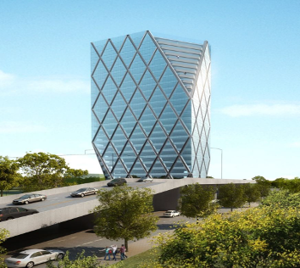
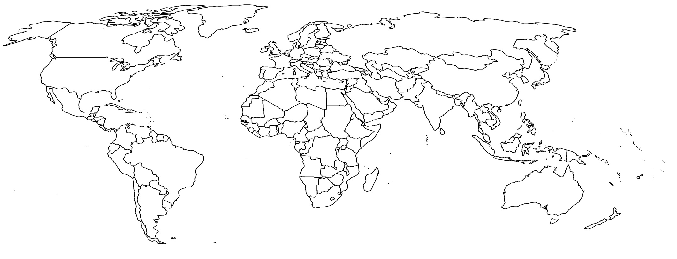
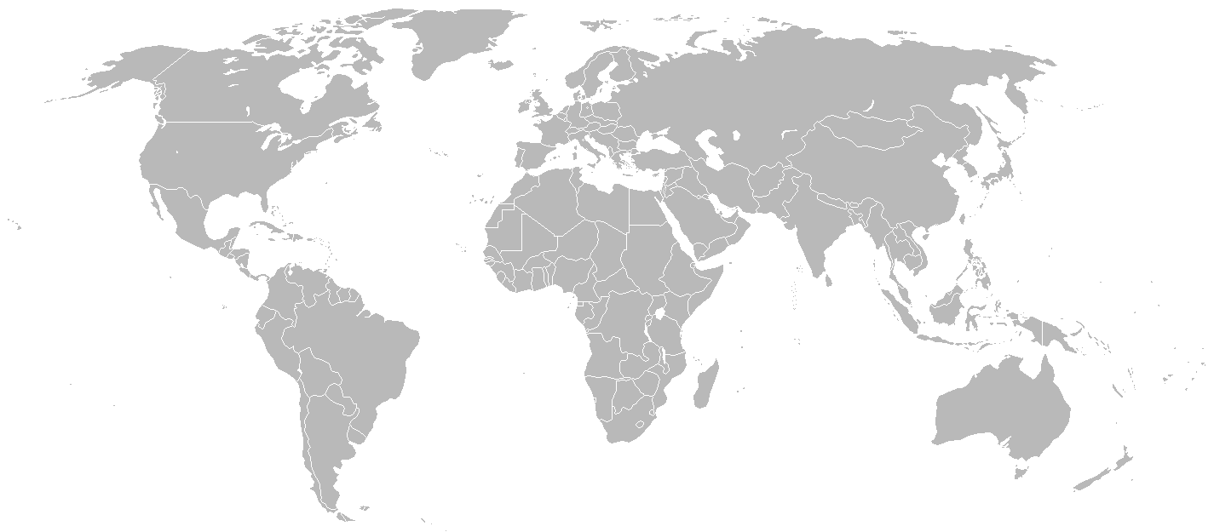
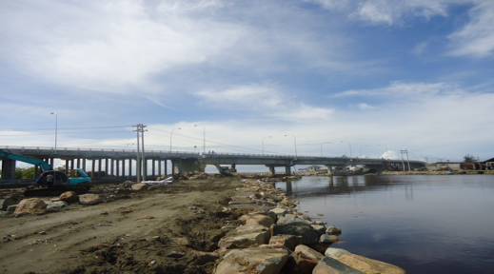
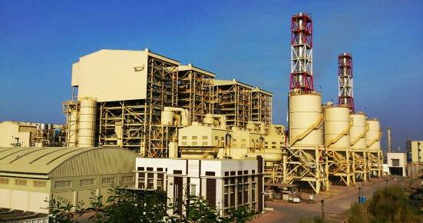
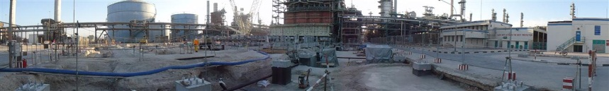
III.工程技術 / Technology
ii.工程產業海外實績案例 / Engineering Industry Foreign Cases
Myanmar：
M Tower design review, construction supervision
Qatar：Petrochemical Plant EPC Project
Indonesia：Highway Supervision Program
Philippines：Power Plant EPC Turnkey
Notes:
11
緬甸：M Tower設計顧問及施工管理
Myanmar：M Tower design review, construction supervision
卡達：乙烯儲槽專案
Qatar：Qapco New Ethylene Cracking Furnaces Project
印尼：國道監造計畫
Indonesia ：Highway Supervision Program
菲律賓：電廠整廠 EPC
Philippines：Petrochemical Plant EPC Project

Slide 13
III.工程技術 / Technology
iii.工程技術服務業之監管 / Administration of Professional Engineering Sector
產業概況 / Sector Overview
Year 2019
 | 家數 Firm | 技師數 PE | 總人數 Staff | 年產值(十億元) Annual Revenue (billion)
工程技術顧問公司/ PE consulting firms | 1,200 | 3,016 | 24,310 | 71.27
技師事務所/ PE offices | 1,232 | 1,277 | 2,604 | 2.83
合計/ total | 2,432 | 4,293 | 26,914 | 74.1
業務重點 / Main Responsibilities
(i)許可及登記 / Permission and Registration
(ii)教育訓練 / Educational Training
(iii)工程倫理 / Ethics of Engineers
(iv)輔導及獎懲 / Guidance, Rewards & Penalties
Notes:
12
The PCC is also responsible for the Professional Engineering Act and the Act Governing the Administration of Professional Engineering Consulting Firms.
Our general duty is to administrate the practices of the PEs and professional engineering consulting firms through registration, training, counseling, guidance, etc.
本會主管技師法、工程技術顧問公司管理條例，負責管理及輔導專業技師及工程技術顧問公司。

Slide 14
III.工程技術 / Technology
iv. 工程技術及經費審議 / Conducting Technical and
Budgetary Reviews of Public Construction Programs
中央各機關辦理重大公共工程計畫，須提送基本設計階段圖說予本會審議。
When conducting major public construction projects, central government entities shall submit drawings of basic design phase to PCC for review.
審議重點：政策一致性、技術可行性、節能減碳措施、經費合理性等。
Main reviewing items: policy consistency, technical feasibility, carbon reduction and energy saving measures, and reasonability of budget.
每年審議數量約400件，節省經費約200億元。
PCC reviews approximately 400 construction projects per year and saves about NT$ 20 billion on the budget.
Notes:
13
When conducting major public construction projects, central government entities shall submit drawings of basic design phase to PCC for review.
中央各機關辦理重大公共工程計畫，須提送基本設計階段圖說予本會審議。
The reviewing items include consistency between projects and policies, technical feasibility, carbon reduction and energy saving measures, and reasonability of budget.
審議的重點包括政策一致性、技術可行性、節能減碳措施、經費合理性等。

Slide 15
III.工程技術 / Technology
v. 鼓勵創新及建立施工綱要規範 / Encouraging Innovation and Establishing Construction Specifications
蒐集公共工程運用之新材料、技術及工法，鼓勵機關透過政府採購法機制納入創新，提升公共工程品質與效益。
Collect information on new construction materials, technologies and methods used in public construction projects to encourage innovation via government procurement process and improve the quality and efficiency of public construction.
為整合劃一全國工程施工規範，建立施工綱要規範，提供標準架構及綱要性內容，作為規劃設計參考並提升工程品質。
Establish the public construction guide specifications, including framework and outlines to unify construction specifications in Taiwan. These specifications are used as the reference for designing and promoting the quality of construction.
Notes:
14
For example, In order to enhance productivity of construction industry and follow the international trend, we encourage agencies to use BIM (Building Information Modeling) in Public Construction. Through establishing a platform with government department, engineering industry and the academia, the experience sharing among each other are enhanced. In addition, it can help domestic industry to familiar with application of BIM technology.
為提升生產力並與國際接軌，鼓勵建築資訊建模(BIM)運用於公共工程，且結合產官學界成立平台，藉由經驗共享，讓國內產業逐步熟悉BIM技術的運用模式。

Slide 16
III.工程技術 / Technology
vi. 推動循環經濟運用於公共工程 / Promote circular economy through infrastructure projects
推動循環經濟政策，協助產業發展，兼顧環境及工程品質。
Promote circular economy policy to both assist industrial development and take into account the environment and engineering quality.
煉鋼轉爐石應用於瀝青混凝土鋪面，預估使用量已大幅提升。
Encourage the use of steel slag in asphalt concrete pavements. The usage of steel slag has increased significantly in estimation.
垃圾焚化爐底渣應用於控制性低強度混凝土材料或道路基底層，不僅節省工程經費，亦有助於環境永續。
Encourage the use of incinerator bottom ash in CLSM or road construction (subbase course/ base course) to not only save construction cost, but also contribute to environmental sustainability.
Notes:
15

Slide 17
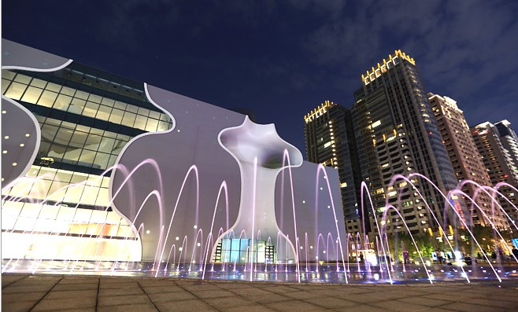
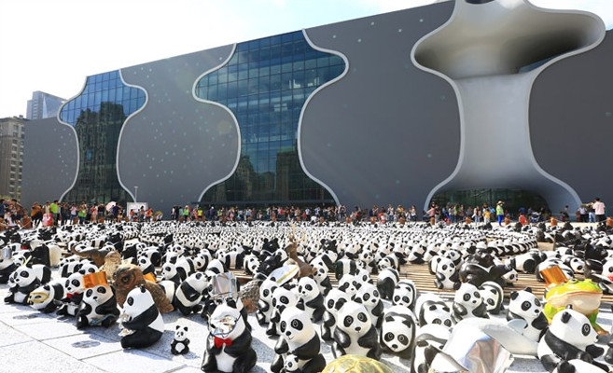
IV.工程管理 / Construction Management
i. 公共工程標案管理資訊系統 / Public Construction
Management Information System
為因應全國各機關每年約三萬件公共工程，本會於2001年自行開發公共工程標案管理系統，目前已累積近60.85萬筆公共工程標案資料。
In response to the demand in managing around 30,000 cases of public constructions on a nationwide scale per year, PCC established the public construction management information system in 2001.Presently, there are more than 608,500 public construction cases in the database.
Notes:
16
PCC established the public construction management information system in 2001.
The system has profound statistical functions .It manages about thirty thousand public works nationwide each year.
本會於2001年由資訊同仁自行開發公共工程標案管理系統，系統擁有完善的統計分析功能，每年有效管理約三萬件公共工程標案。

Slide 18
IV.工程管理 / Construction Management
ii. 公共工程施工品質管理制度 / Public Construction Quality Management System
公共工程三級施工品質管理制度，建立主管機關、主辦機關(含監造單位)及施工廠商權責事項。
The 3-level quality management system covers the responsibilities of competent authorities, procuring entities (including construction supervision unit) and contractors respectively.
施工廠商負責品質管制系統、主辦機關及監造單位負責品質保證系統及主管機關負責施工查核機制。
Contractors are responsible for quality control system. Procuring entities and supervision units are responsible for quality assurance system. Authorities are in charge of the mechanism of Public Construction Inspection.
Notes:
17
In response to the promotion of 3-level quality management system for public construction, the PCC has specified the rights and responsibilities of central and local government entities , agencies in charge and supervisory units, and contractors respectively.
推動公共工程三級施工品質管理制度，本會建立主辦機關、監造單位及施工廠商權責事項。

Slide 19
主辦機關及監造單位
施工品質保證系統
（第二級）
Agencies-in-Charge and Supervision Units
Quality Assurance System
（The second level）
工程會/工程主管機關
工程施工查核機制
（第三級）
PCC /
The Public Construction Surveillance Units
Mechanism of Public
Construction Inspection
（Third level）
廠商施工品質管制系統
（第一級）
Contractors
Quality Control System
（The first level）
全體國民
全民督工系統
Public Oversight of Public Construction
工程施工品質
Public Construction Quality
公共工程品質管理示意圖
Public Construction Quality Management System Schematic Diagram
Notes:
Contractors respectively are responsible for quality control system. Agencies in charge and supervisory units are responsible for quality Assurance system. The public construction surveillance units of agencies in charge of construction are responsible for Mechanism of Public Construction Inspection.
施工廠商負責品質管制系統、主辦機關及監造單位負責品質保證系統及主管機關負責施工查核機制。

Slide 20
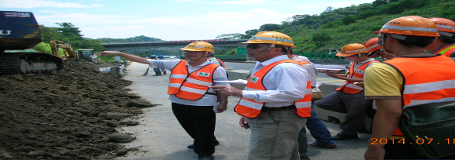
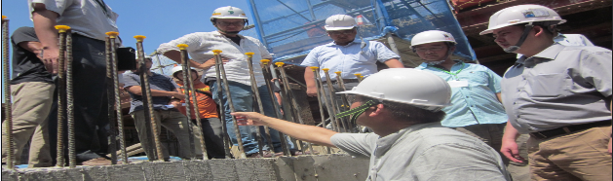
IV.工程管理 / Construction Management
iii. 公共工程施工查核機制 / The mechanism of Public Construction Inspection
為確保公共工程品質，工程會依「政府採購法」規定，要求中央及地方機關成立工程施工查核小組。
In order to ensure the quality of public construction, central and local governments establish construction surveillance units pursuant to the Government Procurement Act.
目前全國有49個查核小組，定期查核所屬工程進度與品質，每年約查核4,200件工程。
Currently, there are 49 surveillance units nationwide,
which regularly inspect the progress and quality of
public constructions. There are approximately 4,200
cases inspected per year.
Notes:
19
Construction inspection units are responsible for regularly and randomly inspection the performance of public construction projects of quality and schedule. There are currently 49 units nationwide and randomly inspecting the performance of quality and progress of public construction projects for a total of 4,200 case every year.
定期查核所屬工程進度與品質，目前全國有49個查核小組，每年約查核4,200件工程。

Slide 21
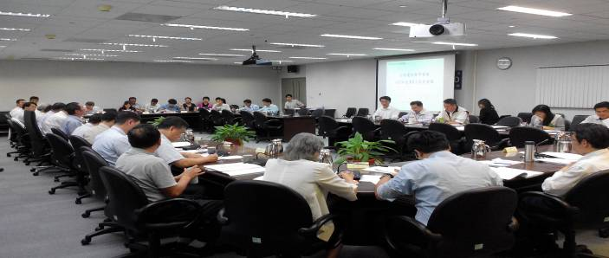
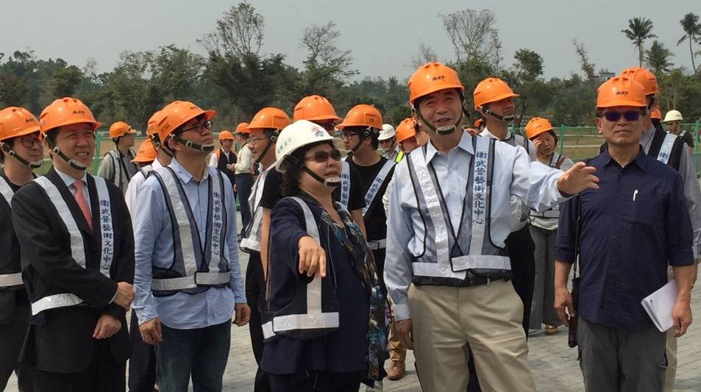
IV.工程管理 / Construction Management
iv.公共建設督導會報 / Public Construction Supervisory Task Force
成立跨部會「公共建設督導會報」
，每月召開會議，檢討各項列管計畫執行情形，協助排除困難問題，促使各機關提升執行效率。
PCC has established a monthly convening inter-ministry "Public Construction Supervisory Task Force,“ reviewing the implementation status of all monitored projects to assist in eliminating difficulties and to enhance the operating efficiency of agencies.
Notes:
20
PCC established an inter-ministry, "Public Construction Supervisory Task Force“, convenes monthly to review the implementation status of all monitored projects over NT$ 100 million, assist in eliminating difficulties, and encourage agencies to enhance operating efficiency .
本會成立跨部會「公共建設督導會報」，每月召開會議，檢討各項一億元以上列管計畫執行情形，協助排除困難問題，促使各機關提升執行效率。

Slide 22
V.爭議處理 / Procurement Settlement
履約爭議處理 / Dispute Settlement of Government Procurement
成立申訴會，處理政府採購申訴及履約爭議調解，以快速有效解決政府採購爭議，並提升政府採購效益。
CRBGP (Complaint Review Board for Government Procurement) was established to deal with complaints and contract dispute mediation effectively and efficiently and improve government procurement performance.
除工程會外，各直轄市及花蓮縣政府亦設置申訴會處理上述爭議。
In addition to PCC, the complaint review board is also established under each Municipal Government and Hualien County Government.
Notes:
21
CRBGP, Complaint Review Board for Government Procurement, was established to authorize dispute cases of government procurement complaint and contract performance dispute mediation, in order to settle the dispute cases of government procurement quickly and efficiently, and also improve the efficiency of government procurement.
成立申訴會，處理政府採購申訴及履約爭議調解，以快速有效解決政府採購爭議，並提升政府採購效益。
In addition to PCC, the complaint review board is also established under each Municipality Government and Hualien County Government.
除工程會外，各直轄市及花蓮縣政府亦設置申訴會處理上述爭議。

Slide 23
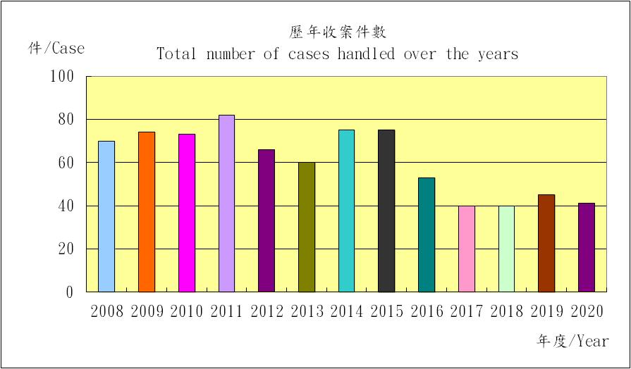
VI.技術鑑定 / Technique Corroboration
重要措施 / Major Measures
接受司法機關對需為工程技術鑑定之公共工程案件，提供專業鑑定意見，解決公共工程爭議。
Provide technique corroboration of public construction upon the requests from judicial authorities to settle public construction disputes.
Notes:
22
Set up the Technical Assessment Committee to provide identification services.
設置鑑定委員會提供鑑定服務

Slide 24
VII.結語 / Conclusion
在日新月異的年代，
精益求精是公共工程委員會不變的方向，
也因為不斷的改革、轉變，
讓流程簡化、效能提升，
使臺灣未來的競爭力更強。
In a time of rapid change,
PCC continues to seek advancements.
Our ongoing efforts in reforming and conforming to trends
enable to simplify procedures, improve performance,
and hence strengthen Taiwan’s competitiveness in the future.
Notes:
23

Slide 25
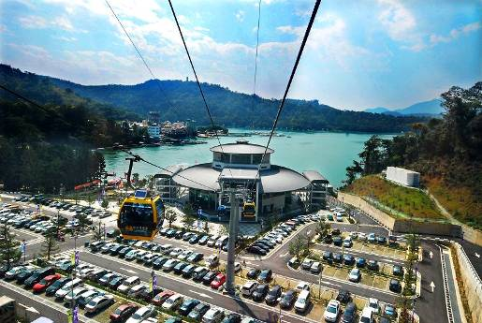

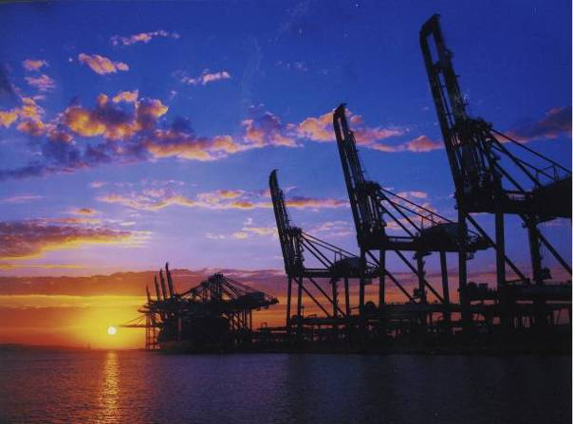

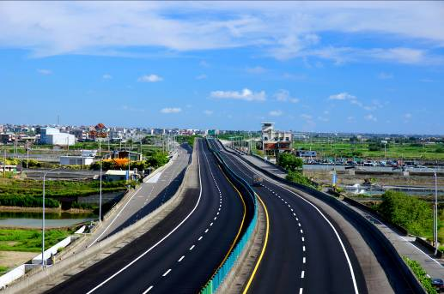
Thank you !

